Slide 1
“The blockchain is the most important technology since the internet itself.”
Mark Andreessen: Cofounder of Netscape; board of directors of: Facebook, eBay, and HPE; World Wide Web Hall of Fame member

Slide 2
Blockchain
Jonas Pfannschmidt & Mateusz Kolder
26/04/2017

Slide 3
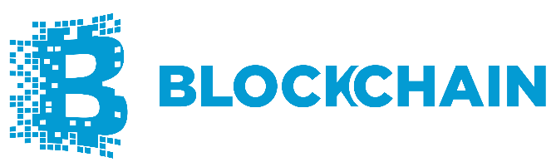
What is Blockchain?
A blockchain is a decentralized, public database that can record transactions in a verifiable and permanent way in a trustless environment
Notes:
Decentralized (distributed ledger), replicated state and content across all nodes. Smart contracts for trusted processes. (Consensus, provenance, immutability and finality) As is (every entity maintains its own ledger)
Uses Cryptographic tokens and addresses(secure unique voucher system), Peer-to-peer networking, Consensus formation algorithm, Turning complete VM(Ethereum can run any programs from within)

Slide 4
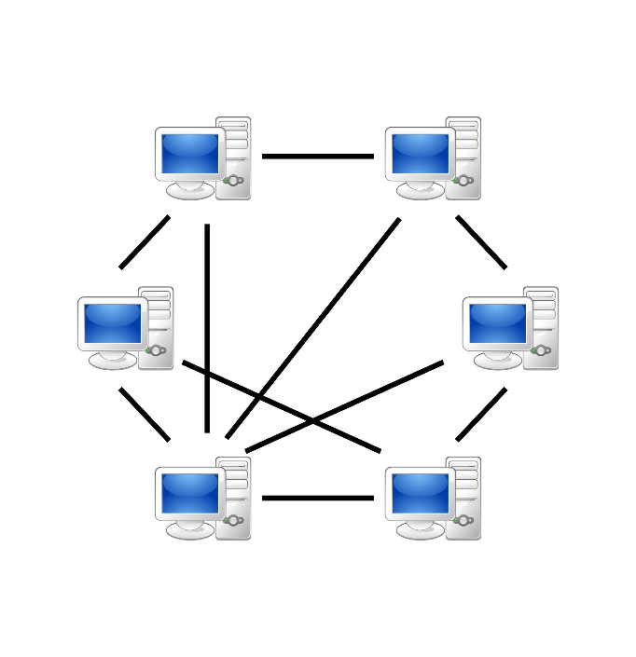
What is Blockchain?
A blockchain is a decentralized, public database that can record transactions in a verifiable and permanent way in a trustless environment
Peer to peer network of nodes without central authority
Notes:
Decentralized (distributed ledger), replicated state and content across all nodes. Smart contracts for trusted processes. (Consensus, provenance, immutability and finality) As is (every entity maintains its own ledger)
Uses Cryptographic tokens and addresses(secure unique voucher system), Peer-to-peer networking, Consensus formation algorithm, Turning complete VM(Ethereum can run any programs from within)

Slide 5

What is Blockchain?
A blockchain is a decentralized, public database that can record transactions in a verifiable and permanent way in a trustless environment
Every participant of a blockchain network can obtain a copy of all data in the blockchain
Notes:
Decentralized (distributed ledger), replicated state and content across all nodes. Smart contracts for trusted processes. (Consensus, provenance, immutability and finality) As is (every entity maintains its own ledger)
Uses Cryptographic tokens and addresses(secure unique voucher system), Peer-to-peer networking, Consensus formation algorithm, Turning complete VM(Ethereum can run any programs from within)

Slide 6
What is Blockchain?
A blockchain is a public, decentralized database that can record transactions in a verifiable and permanent way in a trustless environment
TX 1 TX 2
TX 3 TX 4 TX 5
TX 6
Notes:
Decentralized (distributed ledger), replicated state and content across all nodes. Smart contracts for trusted processes. (Consensus, provenance, immutability and finality) As is (every entity maintains its own ledger)
Uses Cryptographic tokens and addresses(secure unique voucher system), Peer-to-peer networking, Consensus formation algorithm, Turning complete VM(Ethereum can run any programs from within)

Slide 7

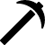
What is Blockchain?
A blockchain is a decentralized, public database that can record transactions in a verifiable and permanent way in a trustless environment
Miners verify the transactions and use a consensus algorithm to agree on the state of the system
Miners usually get paid a fee for their work
Notes:
Decentralized (distributed ledger), replicated state and content across all nodes. Smart contracts for trusted processes. (Consensus, provenance, immutability and finality) As is (every entity maintains its own ledger)
Uses Cryptographic tokens and addresses(secure unique voucher system), Peer-to-peer networking, Consensus formation algorithm, Turning complete VM(Ethereum can run any programs from within)

Slide 8

Bitcoin
Decentralized Digital Currency
Created 2009 by an unidentified entity under the pseudonym Satoshi Nakamoto
As of today all bitcoins in existence are worth $20 Billion
Can be traded for real cash at online exchanges
Major companies (Microsoft, Stripe, Virgin etc.) accept bitcoins as payment

Slide 9
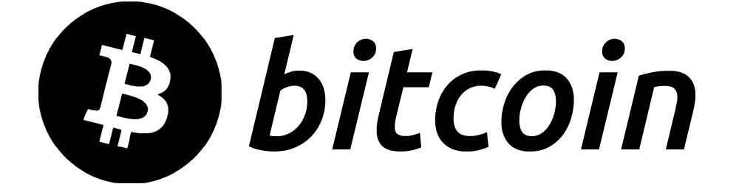
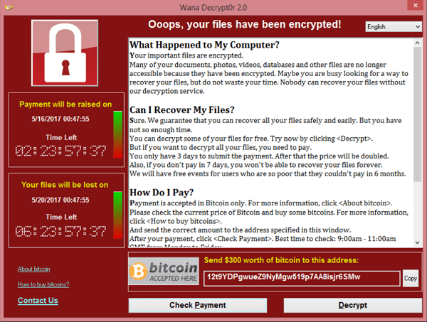
Bitcoin – The Dark Side
Currency of choice for cybercriminals
Ransomware
Silk Road
Slow: 10 – 60 minutes to validate a transaction
Consensus algorithm wastes a lot of energy

Slide 10
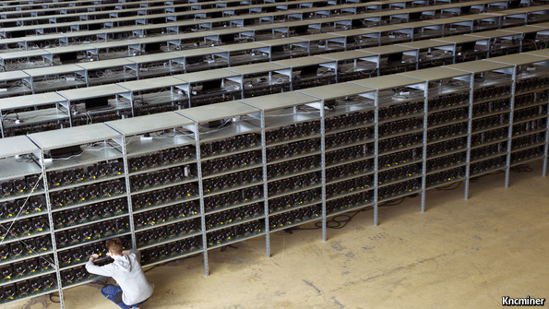
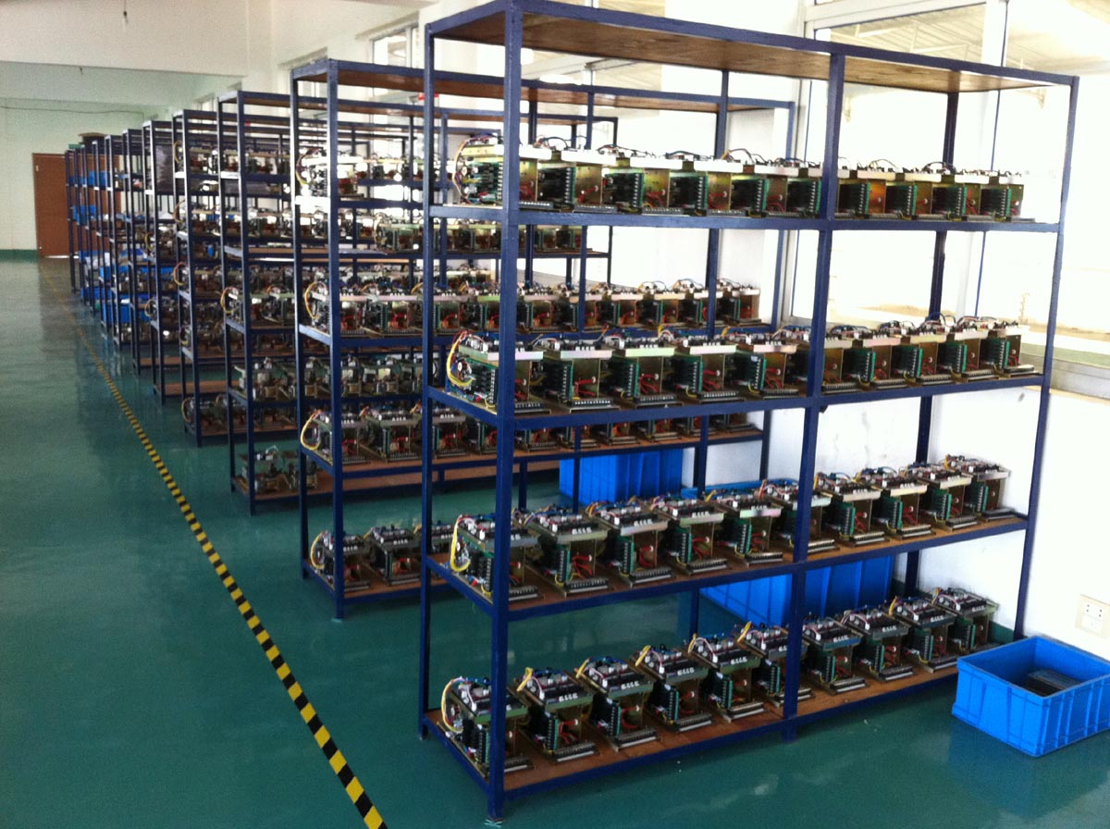
Bitcoin Miners

Slide 11


Slide 12
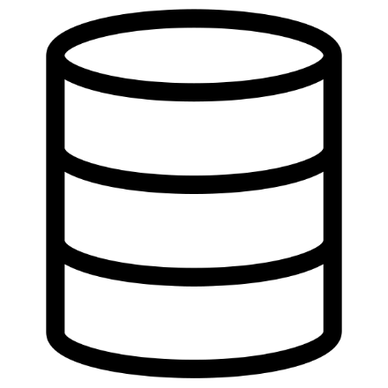
+

Slide 13
+
+

Slide 14
First Generation Blockchains
+
+
Specific use-cases:
Cryptocurrency (Bitcoin)
Decentralized DNS (NameCoin)
Public irreversible database (ColoredCoin)

Slide 15
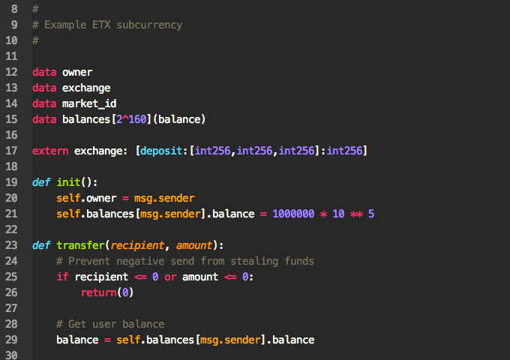
Second Generation Blockchains
+
+
+

Slide 16


Alice
Bob

Slide 17


Alice
Bob

Slide 18
Alice
Smart Contract
Bob

Slide 19
Alice
Smart Contract
Bob

Slide 20
Blockchain Consensus Algorithms
Proof of Work
More computing power -> Higher chance of creating the next block
Uses a lot of computing power/energy
A reward + transaction fees is given to the miner that creates a block
Vulnerable to the 51% attack
Only makes sense with a lot (> 3) participants
Proof of Stake
Stakeholders invest their coins into POS mechanism
Faster and friendlier to the environment than PoW
More coins -> Higher chance of creating the next block
A reward + transaction fees is given to the miner that creates a block
Vulnerable to the 51% attack
Only makes sense with a lot (> 3) participants
Proof of Authority / Permissioned Blockchains
Only authorized nodes are allowed to create blocks
Faster and friendlier to the environment than PoW
Not decentralized!
Only suitable for private blockchains
Typically no rewards or transaction fees
Secure from the 51% attack

Slide 21
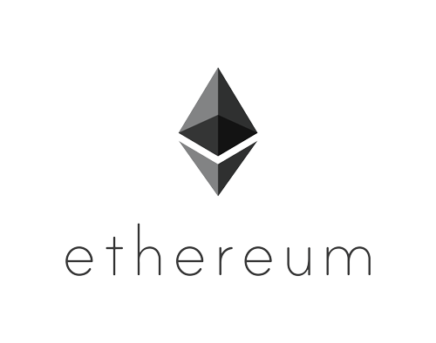

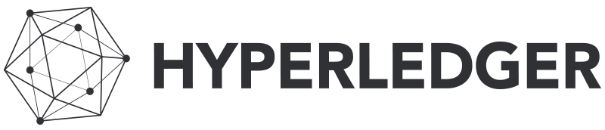
Second Generation Blockchains
Run code that is not controlled by anyone and therefore tamper-proof
High level use cases:
Transparency
Low trust environment
Replacement for legal contracts (especially across jurisdictions)
Payment
Brand new technology: Currently mostly startups and prototypes

Slide 22
Summary
Decentralized Peer-to-Peer System
Strong Encryption
Distributed Database
Irreversible and tamper-proof
Notes:
A blockchain consists of blocks that hold timestamped batches of valid transactions. Each block includes the hash of the prior block in the blockchain, linking the two. The linked blocks form a chain, with only one (successor) block allowed to link to one other (predecessor) block, thus giving the database type its name.
To help illustrate this in a concrete manner, we’ve created a simplified demo blockchain. Instructions on how to build and run the chain are in the readme, and the demo can be run directly from a command line or pushed to Cloud Foundry. The rest of this blog will make use of the demo to highlight various Blockchain characteristics.
The usual technical approach to this would be to create a datastore, create credentials for users, have the users load information into the system securely, and then protect the datastore with passwords, encryption, firewalls, and restrictive interfaces.
But, what about the requirement for independent verification? At any time, anyone should be able to verify the integrity of an entry (or the whole datastore) using “external methods.” This is where the proverbial paradigm shifts:
We can’t trust the system to verify itself
We can’t rely upon the assurances of system creators or operators to determine data validity
We don’t want to rely upon some third party to certify that the data is correct and the system is secure
A common way to ensure that some piece of data has not been tampered with is via the use of one-way hashes. Hashing is a method for creating a mathematical fingerprint of something, and a one-way hash is designed so that it is infeasible to recreate the original data from its hash. Ideally, there should also be a very high unlikelihood of clashes—where two different inputs result in the same hash.
A commonly used hashing function, SHA-256, is useful for this purpose, and our demo includes the Hasherservice, which provides SHA-256 hashes. To illustrate, we can use Hasher to hash the string “helloWorld”:

Slide 23
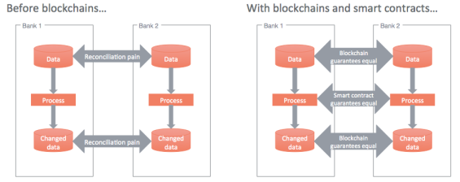
Smart Contracts
Pre-written logic (computer code) between parties
Stored and replicated on the distributed storage platform (blockchain)
Executed and run by the network of connected computers
Results in ledger update
Distributed control
Code runs parallel
Gives transparency and flexibility
Notes:
Agreements between parties posted to the blockchain

Slide 24
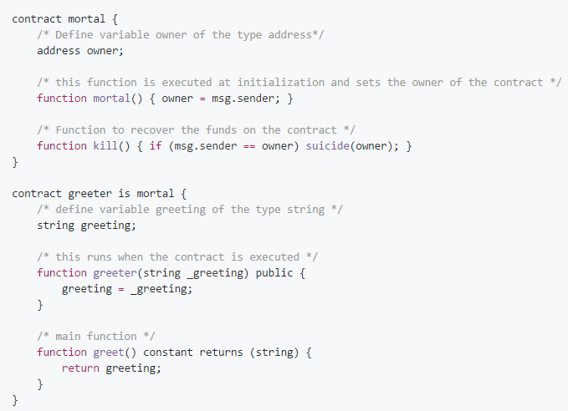
Sample ‘Hello World’ Contract
Using Solidity language
Solidity Compiler
Ethereum Greeter Listener

Slide 25
Blockchain Consensus Algorithms
Proof of Work
Mining a block depends on work of your miner
Uses a lot of energy
Uses computer cycle times to validate transactions
A reward is given for a first miner who solves each block problem
Proof of Stake
Stakeholders invest their coins into POS mechanism.
Stakeholders validate new blocks by utilizing their share of coins on the network (wealth)
Next block is chosen in a deterministic way (assigned to random validator)
No block rewards , miners take transaction fees
Longest chain is the canonical one
Proof of Authority
Does not depend on nodes solving arbitrarily difficult mathematical problems
Uses a number of secret keys and authorities to collaborate and create the longest chain that allow to create new blocks and secure the Blockchain
Irreversible and offers near-instant transaction

Slide 26

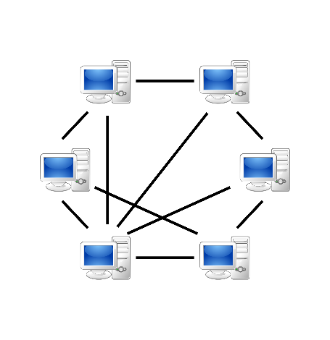
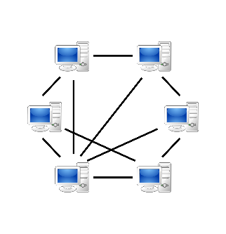
Public Blockchain
Public blockchain is permission less i.e. anyone can validate a transaction, add block and read data.
Designed to replace trusted 3rd party and create trust between parties that don't fully trust each other

Slide 27
Private Blockchain
Private (permissioned) blockchain in which entities are known and allowed to add blocks within a private network
Data in internal blockchain can be read by anyone by accessing one of the nodes
All participants are known and trusted, all govern by legal contracts

Slide 28
Blockchain Use Cases
Internet of Things
Data Storage
Record Management
Identity Management
Healthcare
Supply Chain Management
Payments
Regulatory Compliance and Audit
Land Rights
Asset depository

Slide 29
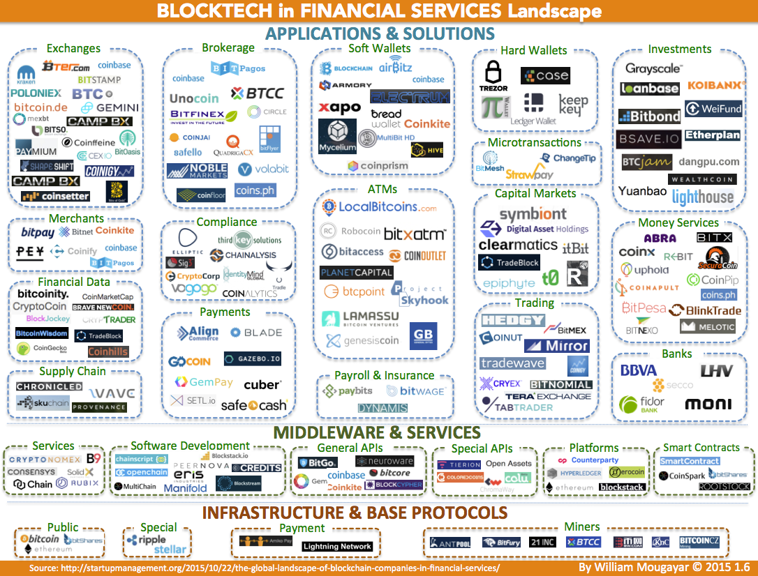
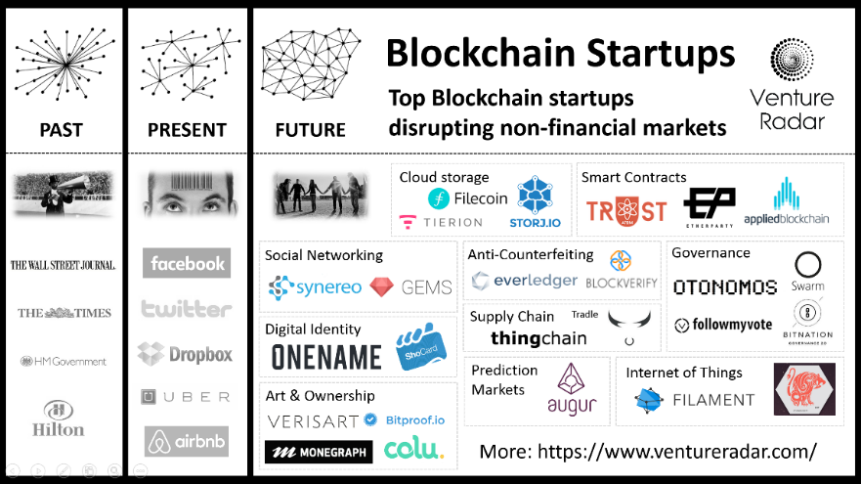
Blockchain Services and Companies

Slide 30
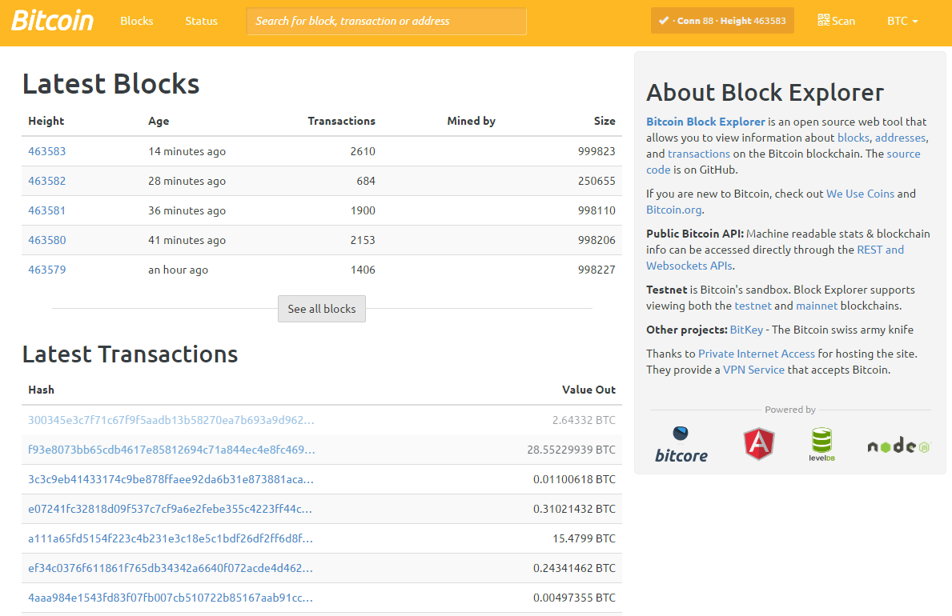
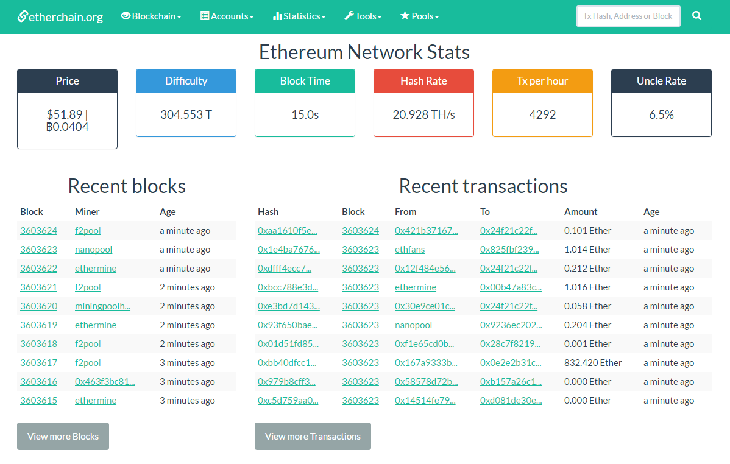
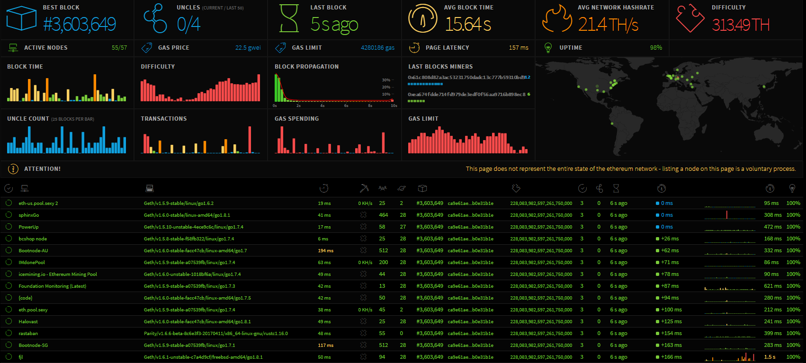
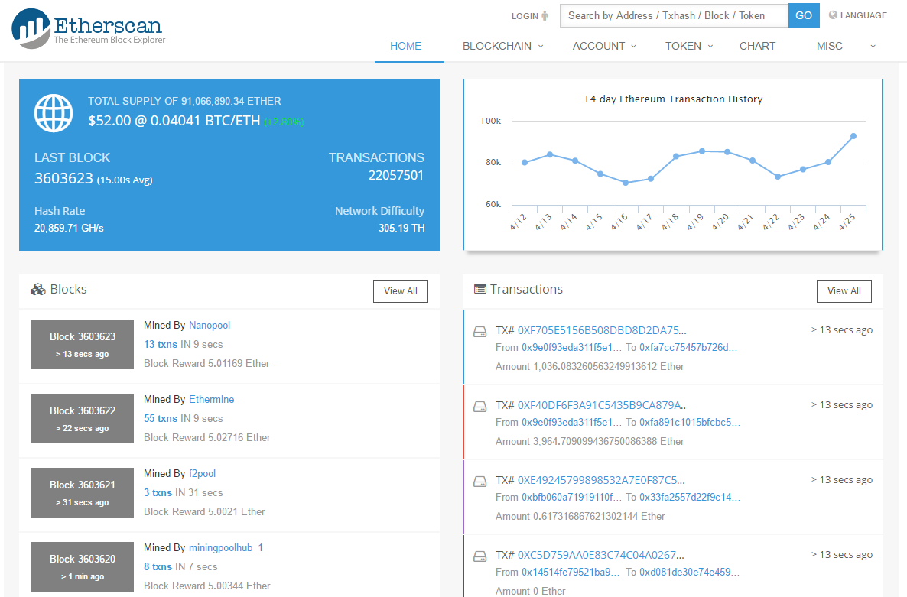
Blockchain Monitors

Slide 31
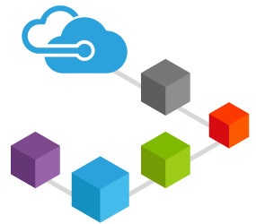
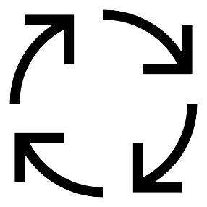

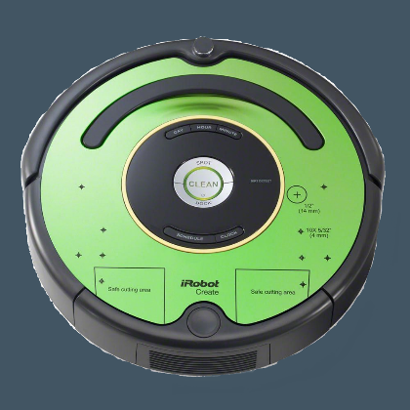
HPE Discover 2017
Blockchain system for autonomous robots
Uses Smart Contracts and Ethereum Blockchain as an underlying Infrastructure
Customer requesting the service of the robot can do so using app/website interface
Customer specifies the cleaning time
Service provider that distributes the robots sets the price per minute (defined within the Blockchain)
Microsoft Azure Blockchain as a Service

Slide 32

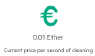
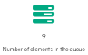
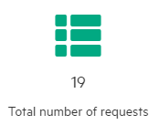
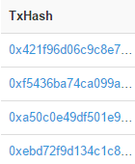
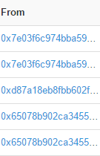


HPE Discover 2017
User Interaction:
Users will interact with a robot using phone app/webUI
Robot will clean a room based on a User ID
Charging points available in Room I & II and Docking Hub
Live Blockchain transaction log and service progress presented on TV and mobile device
User 1
User 2
Room 1
Room 2
Clean
Clean
Room I
Room II

Slide 33



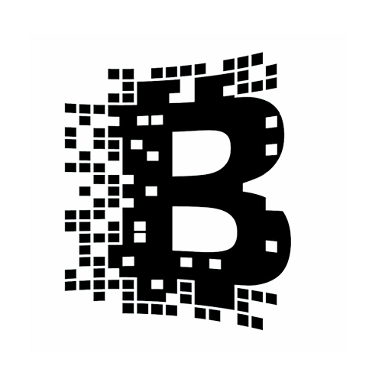


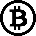






Blockchain
Traditional
Centralized System
Service Provider
Electricity Provider
Legal Contract
End User
Blockchain Provider
Bank

Slide 34
Comparison
Blockchain Way | Traditional Way
Decentralized | Centralized
Multiparty trust | Must trust the operator
Shared ownership | Proprietary silos of ownership
Certifiable immutability by design | Rely on external tools for integrity
Embedded, low cost, fast payment | Rely on third-party payment systems
Ecosystem simplification | Multiple heterogeneous systems
Expandability of entity types | Complex addition of entity types
Shared, transparent code | Private, non-transparent logic
Native authorization available | Rely on external authorization mechanisms
Enhanced traceability and auditability | Rely on external auditing tools
Smart contracts | Static, 1-to-1, legal contracts
Transparent transactions | Non-transparent transactions

Slide 35

Proposed Transactions (Smart Contracts)
Sales
Electricity (EU-SP)
Electricity (SP-EP)
Sales
Electricity (EU-SP)
Electricity (SP-EP)
Between User and Service Provider
Describes Following Conditions:
Price per Minute
Duration of Cleaning
Job Completion
Transaction ID
Robot ID
User ID
…
Between User and Service Provider
Describes Following Conditions:
Electricity Cost / kW
Duration of Charging
Battery Level
Transaction ID
Robot ID
…
Between Service and Electricity Providers
Describes Following Conditions:
Electricity Cost / kW
Duration of Charging
Battery Level
Transaction ID
Robot ID
…

Slide 36
Blockchain Resources
Ehtereum - https://www.ethereum.org/
Hyperledger - https://www.ethereum.org/
Parity Ethereum Client - https://parity.io/
Bitcoin - https://bitcoin.org/en/
Block Explorer - https://blockexplorer.com/
EthStats - https://ethstats.net/
EtherScan - https://etherscan.io/

Slide 37
Thank You
Jonas and Mateusz

